Slide 1

Active Record and Models
Akshay Simha S R
Software Developer
889 253 8433
asimha@qwinix.io
Sasi Kumar
Senior Software Developer
303 459 4310
snarayanasamy@qwinix.io

Slide 2

Content
Introduction to ORM
Convention and Configuration
Creating Active Record Model
CRUD operations
Validations
Associations

Slide 3

Introduction To ORM
ORM Object-Relational Mapping (ORM) allows you to work with objects and have them saved to the database automatically. It can greatly simplify create-read-update-delete (CRUD) operations and make your code more object-oriented

Slide 4
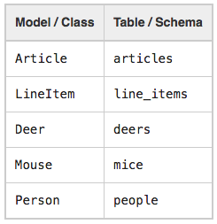
Convention and Configurations
Naming Conventions

Slide 5
Convention and Configurations
Schema Conventions
Foreign keys - These fields should be named following the pattern singularized_table_name_id (e.g., item_id, order_id). These are the fields that Active Record will look for when you create associations between your models.
Primary keys - By default, Active Record will use an integer column named id as the table's primary key.
Created_at
updated_at

Slide 6
Creating Active Record Model
class Product < ApplicationRecord
end

Slide 7

CRUD
Product = Product.Create(name: product_one, price:100)
Product = Product.new Product.name = “laptop”| Product.price = 100 Product.save
product = Product.new do |p| p.name = “laptop” p.price = 100 end

Slide 8
CRUD
Read
products = Product.all
product = Product.find_by(name :”BMW”)
products = Product.where(name: BMW, class: ‘S7’).order(created_at: :desc)

Slide 9
CRUD
Update
product = Product.find_by(name: ‘BMW’)
product.name = ‘BENZ’
product.save
product = Product.find_by(name: BMW)
product.update(name: 'BENZ')

Slide 10
CRUD
Delete
product = Product.find_by(name: 'BENZ')
product.destroy

Slide 11
Validations
Validations are used to ensure that only valid data is saved into your database.
Client-side validations
Controller-level validations
Controller-level validations

Slide 12
Validations
Example:
class Person < ApplicationRecord
validates :name, presence: true
end
Person.create(name: "John Doe").valid? # => true
Person.create(name: nil).valid? # => false

Slide 13
Validations Methods
Test case
it "should validate the post validation" do
post = Post.new()
expect(post.valid?).to be_falsey
end
it "Should validate precense of name" do
post = Post.new(name: "name", title: "title")
expect(post).to be_valid
end

Slide 14
Validations Methods
Errors
>> p = Person.new
# => #<Person id: nil, name: nil>
>> p.errors.messages
# => {}
>> p.valid?
# => false
>> p.errors.messages
# => {name:["can't be blank"]}
>> p = Person.create

Slide 15
Associations
belongs_to
has_one
has_many
has_many :through
has_one :through
has_and_belongs_to_many

Slide 16
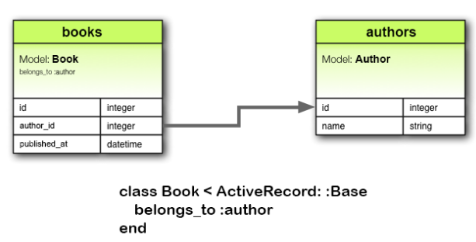
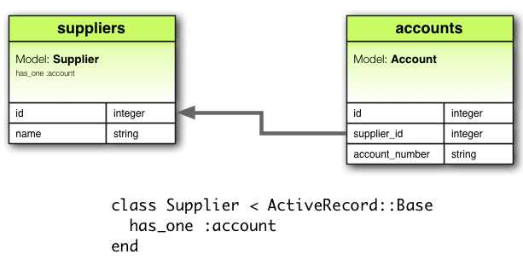
Associations
Belongs_to has_one

Slide 17
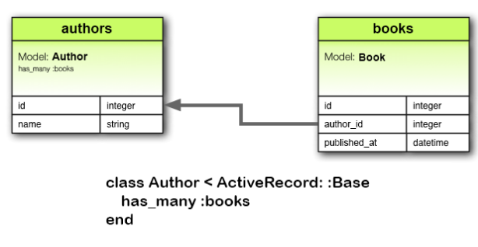
Associations
Has_many

Slide 18
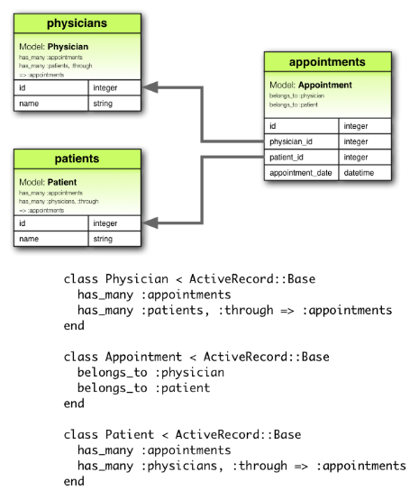
Associations
has_many :through

Slide 19
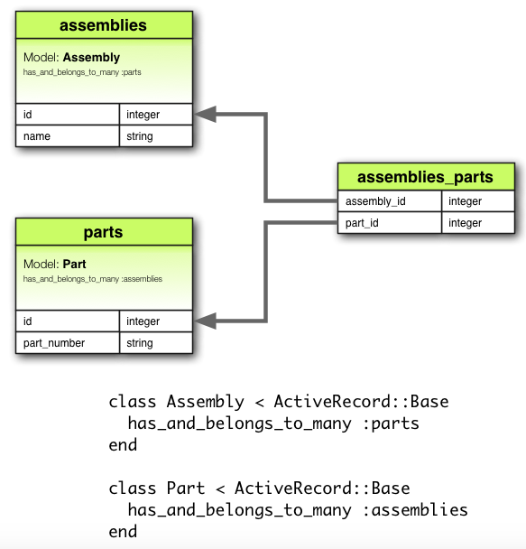
Associations
has_one :through

Slide 20
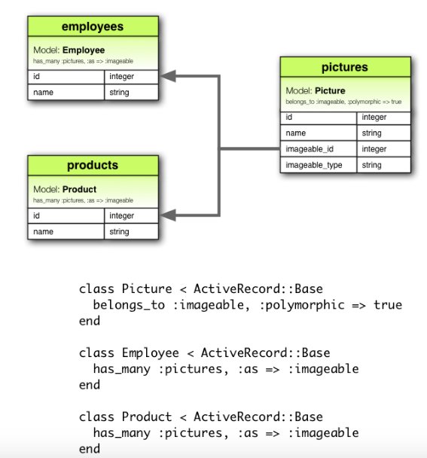
Associations
has_and_belongs_to_many

Slide 21





T H A N K Y O U
HQ I North America 9155 E Nichols Ave, Suite 300 Centennial, CO 80112
www.qwinix.io | 303 459 4310
facebook.com/qwinix @Qwinix Qwinix Technologies

